Slide 1
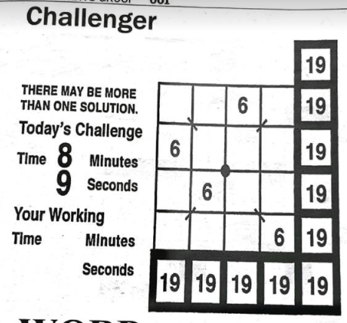




pSUS: A Challenger Puzzle Solver Using SMT
Tyler Ekaireb | Gautam Mundewadi | Ganesh Sankaran
Contributions
User Workflow
Experimental Results
A symbolic compilation formalization for Challenger
A Challenger puzzle solver and generator
pSUS (Puzzle Solver Using SMT)
Can be generalized to other puzzles
A dataset of 22 real-world Challenger puzzles
A set of experiments that evaluate pSUS
Background
Goal: given a puzzle with holes, fill them in such that
All rows sum to target sums (rightmost column)
All columns sum to target sums (bottom row)
Both diagonals sum to target sums (corner entries)
Puzzle can be expressed as an SMT formula
Quantifier-free linear integer arithmetic constraints
User is unable to solve a real-world Challenger puzzle ☹
The number of operations Z3 executed to solve real-world puzzles had almost no association with human solving time. This may suggest that humans solve this puzzle in a very different way than a CDCL-based approach.
19
_ _ 6 _ 19
6 _ _ _ 19
_ 6 _ _ 19
_ _ _ 6 19
19 19 19 19 19
Tool Architecture
User converts puzzle to an input format for our tool
python3 solver.py -i puzzle1.txt -o solved.txt
User calls our tool from the command line
19
9 1 6 3 19
6 3 9 1 19
3 6 1 9 19
1 9 3 6 19
19 19 19 19 19
The number of operations Z3 executed to solve randomly generated puzzles increased with the
number of holes in the puzzle (looks exponential)
size of the puzzle (looks quadratic)
Our tool outputs the solved puzzle in a file
CMPSC 292C, Spring 22 | Thanks to Professor Yu Feng
Notes:
1

